Slide 1
Sprocket Central Pty LTd
Data Analytics Approach
Data Analytics Team
Shikhar Kumar Dixit

Slide 2
Agenda
Data Exploration: Understanding the Dataset
Model Development: Testing the dataset with models
Interpretation & Report: Visualization and Presenting findings.
Copyright Date: 18/04/2021

Slide 3
Introduction
Sprocket Central Pty Ltd is a long standing client of KPMG who specialises in Bikes and accessible cycling accessories to the riders. This presentation is a overview of the Data Set Provided by them.
We at KPMG have analyzed and explored the Dataset and found some probable meaningful insights which we will be sharing through this presentation.

Slide 4
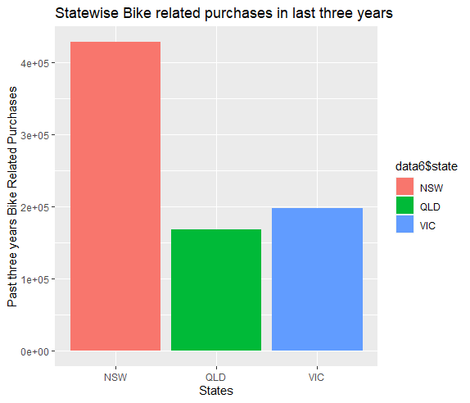
Statewise Bike Related
Purchases in the last three Years.

Slide 5
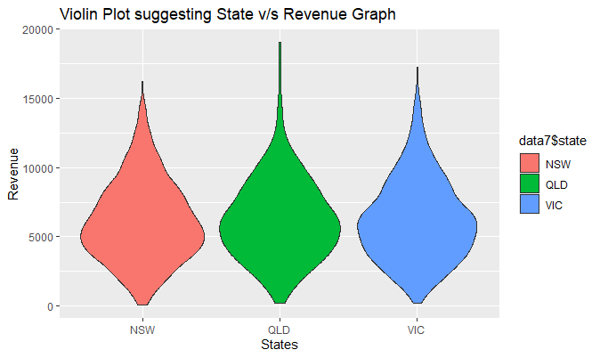
Plot suggesting Statewise Revenue

Slide 6
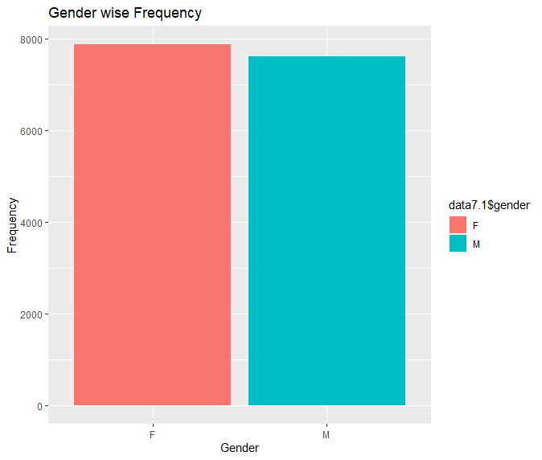
Graph Suggesting
Gender wise Frequency

Slide 7
Thank You

